Slide 1

Exploratory Data Analysis on AMCAT

Slide 2
About me
Aravinth B
I started my career by pursuing a degree in Mechatronics, a field that has provided me with a strong foundation in Mechanics, Electronics and Computer Control Systems.
Recognizing the pivotal role that data science plays in the realm of robotics and artificial intelligence. I honed my skill in Python programming. My passion led me further to Explore the world of AI and machine learning.
Beyond the realms of technology, I am also deeply intrigued by the dynamics of finance and the equity market. As a long-term investor in the Indian stock market, I continuously seek to expand my knowledge and understanding of financial instruments and investment strategies.
In my leisure time, you can often find me on the cricket field, honing my skills as a player and immersing myself in the thrill of the game. Additionally, I am an avid coin collector, finding joy in uncovering the stories and history behind each unique piece in my collection.

Slide 3
Agenda
Objective of the Project
ETL
Summary of the Data
Exploratory Data Analysis:
Data Cleaning Steps
Data Manipulation Steps
Univariate Analysis Steps
Bivariate Analysis Steps
Research Question
Conclusion

Slide 4
Objectives
To perform Univariate and Bivariate Analysis on AMCAT Data
To Identify the patterns and relationships between different features
To solve the research question provided on the project documentation
To provide conclusion of all Insights derived from the Data

Slide 5
Data Summary
The dataset was released by Aspiring Minds from the Aspiring Mind Employment Outcome 2015 (AMEO).
The study is primarily limited only to students with engineering disciplines.
The dataset contains the employment outcomes of engineering graduates as dependent variables (Salary, Job Titles, and Job Locations) along with the standardized scores from three different areas – cognitive skills, technical skills and personality skills.
The dataset contains around 40 independent variables and 4000 data points.

Slide 6
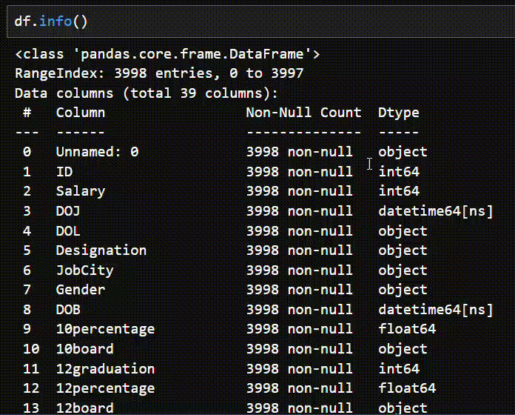
Data Overview

Slide 7
Data Cleaning
Duplicates Finding and Removal.
Text and Date Manipulation to standardize through out all Entries.
Feature Extraction on Date by calculate Age and Year of Experience (consider '2015-12-12 00:00:00’ as present date).
Remove unwanted features.

Slide 8
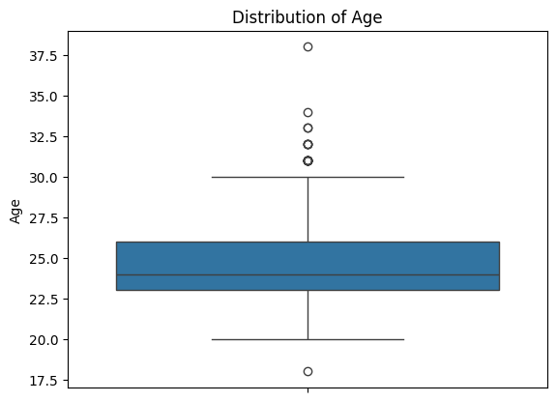
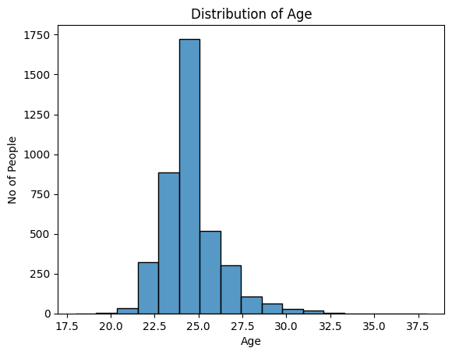
Univariate Analysis on Age
Presence of Outlier in Box plot proves that AMCAT exam don't have any age Restriction
Maximum number of people appear for AMCAT was at the age of 24.
Mostly Adult people Age from 23 to 26 write this Exam.

Slide 9
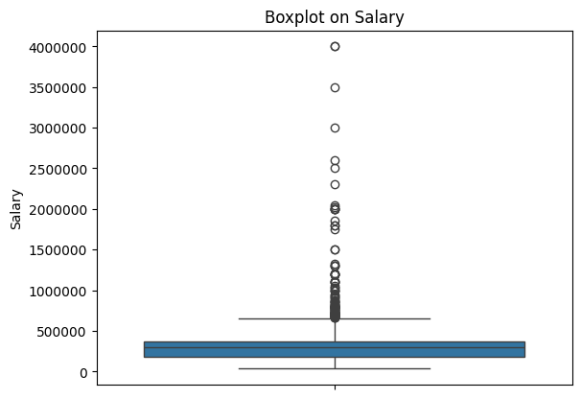
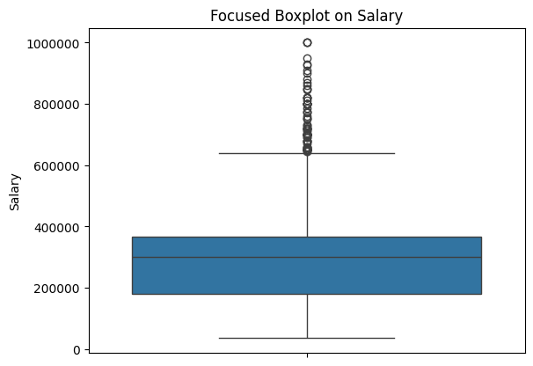
Univariate Analysis on Salary
Salary spread lies below 5 Lakhs.
Outliers may due to experienced professional with high salary also appear for the exam.
Most people salary is in the range of 2 to 4 Lakhs
Median salary of Engineer is lies around 3 Lakhs
Outlier show many people earn more than range also.

Slide 10
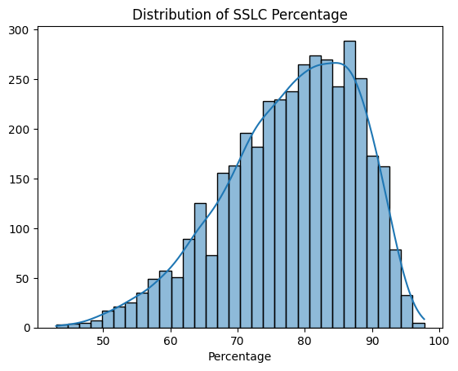
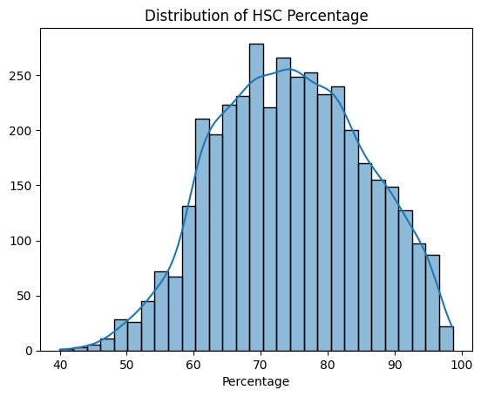
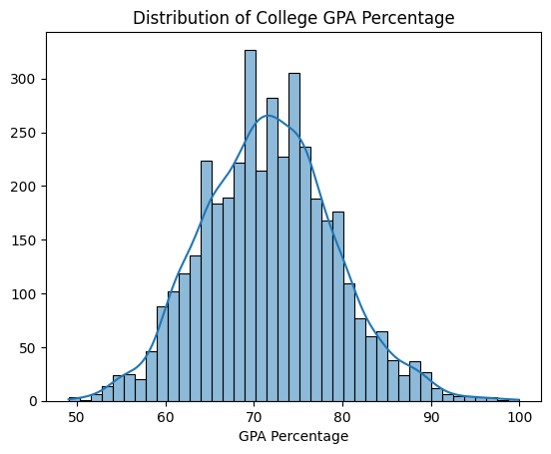
Univariate Analysis on Academics
SSLC histogram is left skewed it shows that most of student got very high mark 75 to 90 percentage
In HSC, performance of student start decreasing most student got High mark from 65 to 85 percentage
In College Performance even degraded and percentage lies in range of 65 to 80 Percentage.
From SSLC to College the data shift from left skewed to a approximate Normal Distribution.

Slide 11
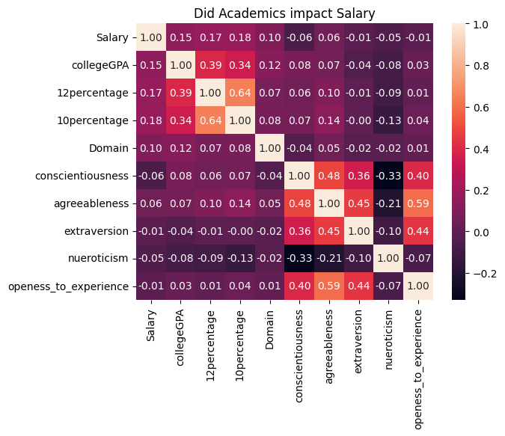
Academics impact Salary
We can’t find any strong correlation with salary and academic performance of a student
So Academics does not have any impact on salary skill will make you unique and help to get more Income.

Slide 12
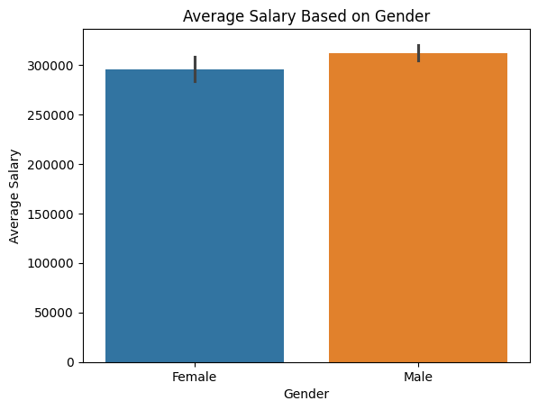
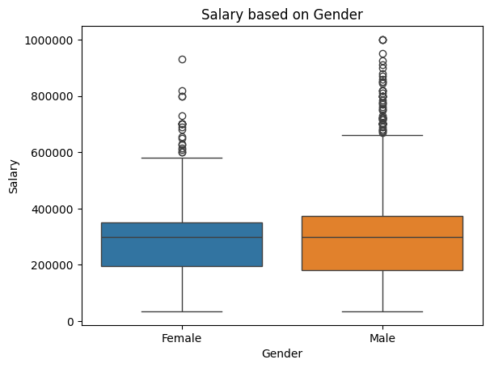
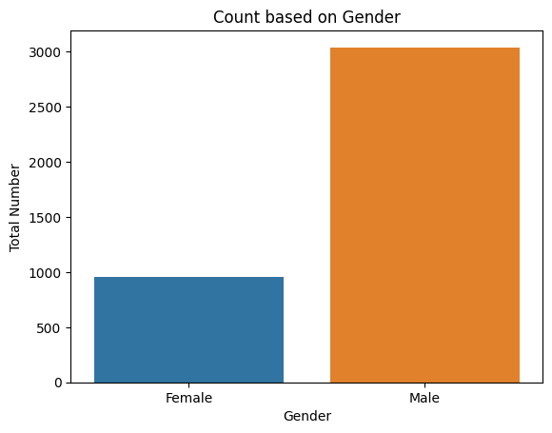
Analysis on Gender
There is a imbalance between female and male count. In Exam Males appear more than female.
Even imbalance between male and female, the average income is uniformly distributed so Male and female earns almost same.
In box plot male’s Income range was slightly above than female.

Slide 13
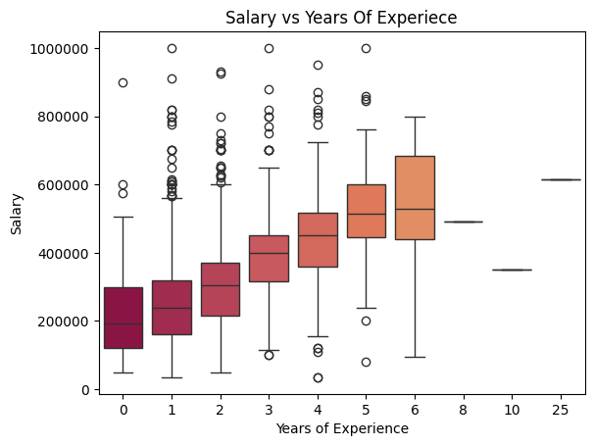
Salary and Years of Experience
From the box plot the median salary for every year of experience got increases gradually with it range also.
Very few data only available for experience above 6 years so that we can’t see those distributions properly.
Outlier in every year of experience state that change of getting more hikes also possible.

Slide 14
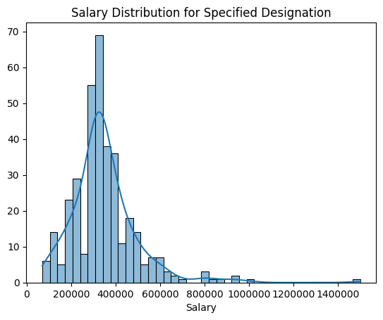
Research Questions
Times of India article dated Jan 18, 2019 states that “After doing your Computer Science Engineering if you take up jobs as a Programming Analyst, Software Engineer, Hardware Engineer and Associate Engineer you can earn up to 2.5-3 lakhs as a fresh graduate.
Following Distribution is approximately Normally Distributed by apply Empirical rule with 68 percentage of confidence we can say that salary lies between 2.2 to 4.5 Lakhs
95 percentage of confidence we can say that Salary lies between 1 to 5.5 Lakhs.
Accept Alternate Hypothesis with a confidence level of 68%

Slide 15
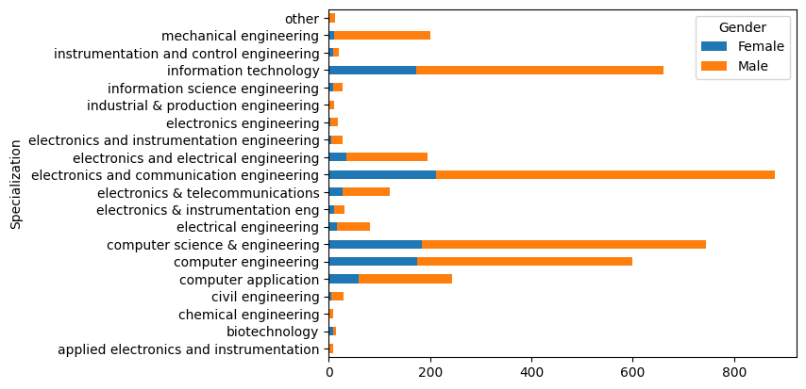
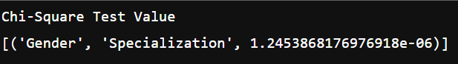
Research Questions
Is there a relationship between gender and specialization? (i.e. Does the preference of Specialization depend on the Gender?)
From visualization method also we can able to notice that in some Specialization there is no female and vice versa. So there is relationship between Gender and Specialization.
Non-Visual statistical method Chi-Square Test also prove that the relationship between Gender and Specialization exists.

Slide 16
Conclusion
There is no relationship between Academics performance and Salary. Salary is based on our skill, talent and other factors.
Salary is strongly positively correlated with Experience.
Both male and female average salary was almost equal.
People work in Bangalore gets more Salary.

Slide 17

THANK YOU

